Slide 1

Graduation Project: Swipe Advisor

Slide 2

The team
Yuval Ofek – Software Developer at Intel Corp, and 3rd year Computer Science student.
Dan Davidovich – Officer in Flotilla 13 with the rank of major and 3rd year Computer Science student.
Idan Asayag - Frontend Developer Student at Elta Systems Ltd, and 3rd year Computer Science student.
Omer Ben David - Software Developer Student at IDF, and 3rd year Computer Science student
Lior Hassin – 3rd year Computer Science student.

Slide 3
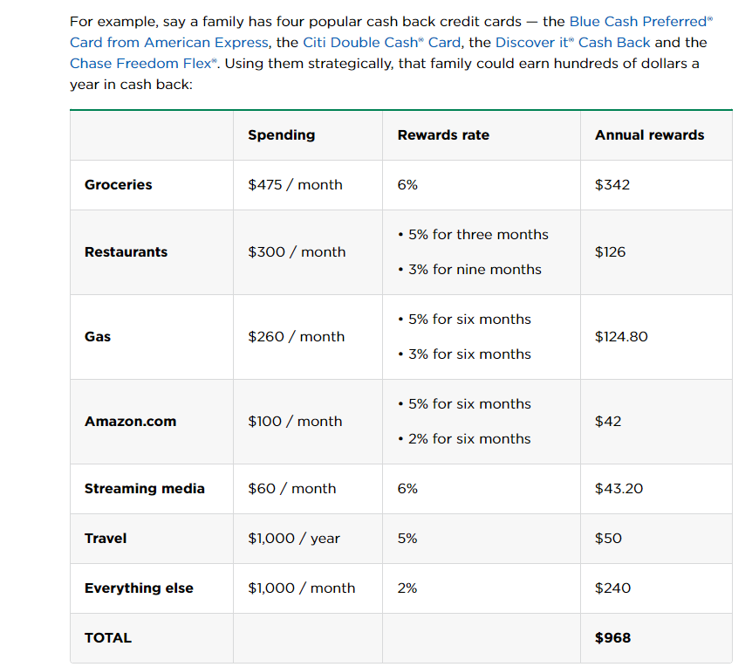
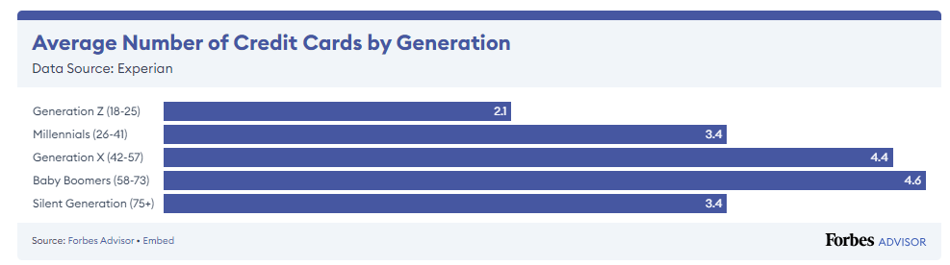
The problem
With the multitude of credit cards offering rewards and various benefits, consumers face the challenge of choosing the most profitable card for their specific transaction.
As of 2022, 82% of US residents hold at least one credit card (3 cards in average).
How many credit cards do americans have | Forbes
31% of people still fail to redeem any rewards annually.
The cost of Unused Credit Card Rewards | BECU
$2278 / month
Why every purchase should be on a credit card | NerdWallet

Slide 4

The solution
Simplify the card selection
The app will keep the data of benefits within credit cards (both general benefits and specific benefits between credit card to business).
The users can select their preferences (Nominal profit, Lowest price or Points, and arrange their preferred cards in a list).
The customer will enter the business name and the transaction amount - and the algorithm will sort all the cards from the card with the most money saved to the lowest.
The app includes a premium account with unlimited cards, unlimited recommendation usage, and no ads.

Slide 5
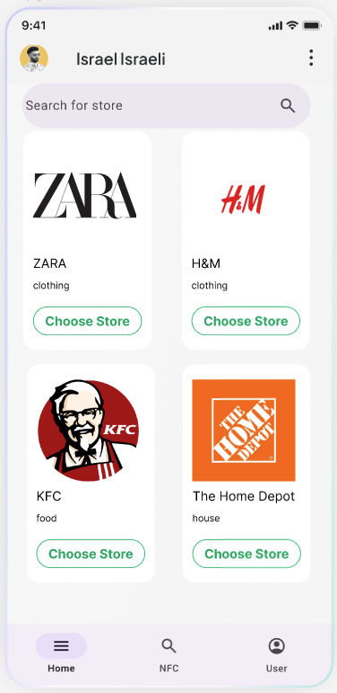
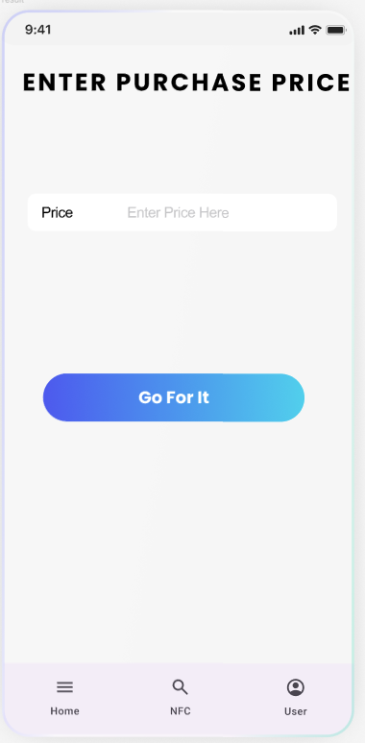
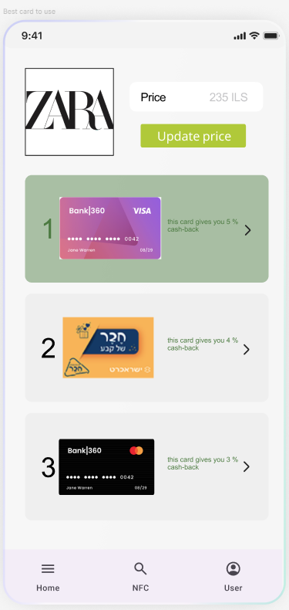
The solution

Slide 6



Competition
Google Pay and Apple Pay: Default credit card selections without considering.
Fid: consolidates all the benefits from the user's credit cards and clubs, allowing to view the benefits belonging to each card or club - does not have a recommendation service, nor a user preferences.
WalletFlo: Focuses on post-transaction rewards accumulation, available only in the American market.

Slide 7
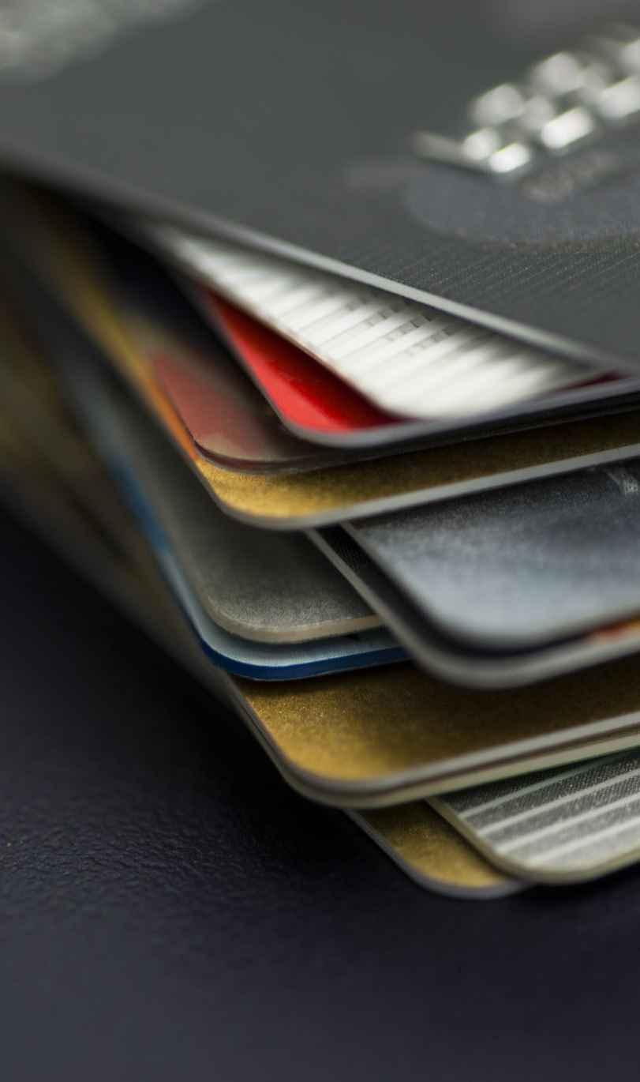
Market
In 2023, the total value of digital payment transactions in the U.S. was approximately $2.04 trillion (2,040,000,000,000 USD). The digital payments sector is expected to continue growing at an annual rate of 14.66% through 2027​.
About 80% of credit card holders possess more than one credit card - amounts to approximately 265.6 million people.
3 is the average number of cards for every person who uses credit cards.
Around 50% of American credit card holders reported actively utilizing the rewards associated with their credit cards.
*How Do Consumers Feel About Credit Cards?

Slide 8

Join us in our mission to help millions save money on every transaction.

